Slide 1
CS 3104 – OPERATING SYSTEMS
Chapter 8
Deadlocks

Slide 2
CHAPTER 8: DEADLOCKS
System Model
Deadlock in Multithreaded Applications
Deadlock Characterization
Methods for Handling Deadlocks
Deadlock Prevention
Deadlock Avoidance
Deadlock Detection
Recovery from Deadlock

Slide 3
CHAPTER OBJECTIVES
Illustrate how deadlock can occur when mutex locks are used
Define the four necessary conditions that characterize deadlock
Identify a deadlock situation in a resource allocation graph
Evaluate the four different approaches for preventing deadlocks
Apply the banker’s algorithm for deadlock avoidance
Apply the deadlock detection algorithm
Evaluate approaches for recovering from deadlock

Slide 4
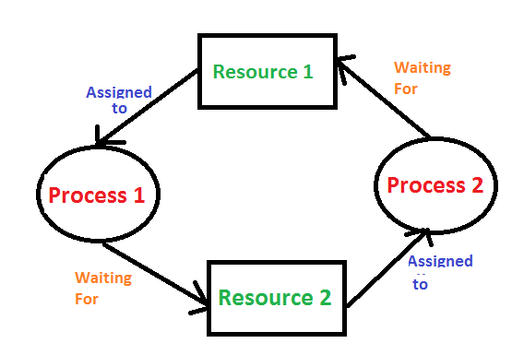
DEADLOCK
A situation that occurs in OS when any process (thread) enters a waiting state because another waiting process (thread) is holding the demanded resource
A situation where a set of processes (threads) are blocked because each process (thread) is holding a resource and waiting for another resource acquired by some other process (thread)
A set of blocked processes (threads) each holding a resource and waiting to acquire a resource held by another process (thread)

Slide 5
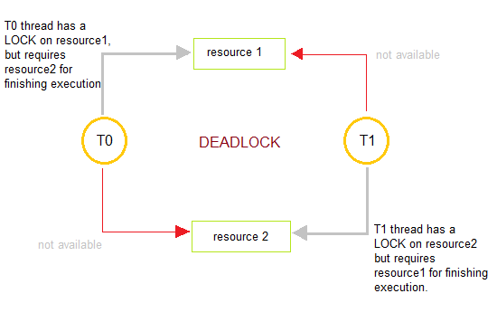
DEADLOCK
Earliest computer operating systems ran only one program at a time.
All of the resources of the system were available to this one program.
Later, operating systems ran multiple programs at once, interleaving them.
Programs were required to specify in advance what resources they needed so that they could avoid conflicts with other programs running at the same time.
Eventually some operating systems offered dynamic allocation of resources.
Programs could request further allocations of resources after they had begun running.
This situation led to the problem of the deadlock.

Slide 6
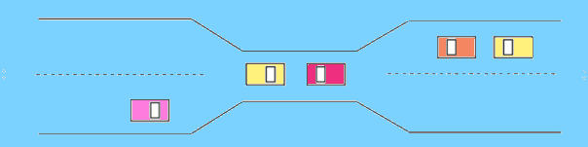
DEADLOCK: REAL-WORLD EXAMPLE
TRAFFIC which is going ONLY in ONE DIRECTION
Here, a BRIDGE is considered a RESOURCE
So, when DEADLOCK happens, it can be easily resolved if one car backs up
Preempt resources and rollback
Several cars may have to be backed up if a deadlock situation occurs
So starvation is possible

Slide 7
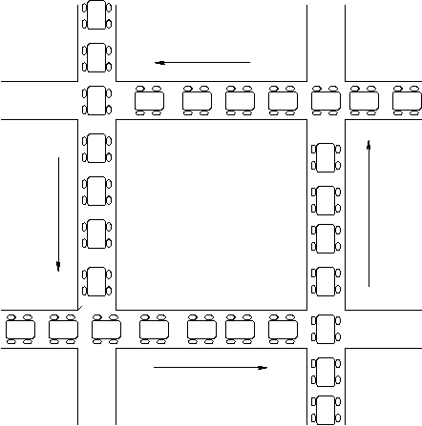
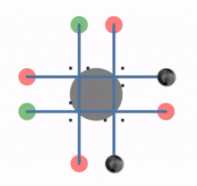
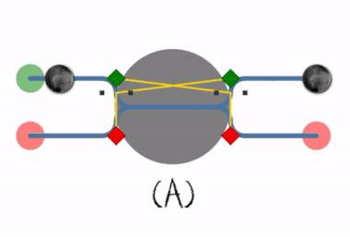
DEADLOCK
A common problem in multiprocessing where several processes share a specific type of mutually exclusive resource
A common problem in:
multiprocessing systems,
parallel computing, and
distributed systems:
where software and hardware locks are used to arbitrate shared resources and implement process synchronization

Slide 8
SYSTEM MODEL
System consists of resources
Resource types: R₁, R₂, . . ., R_{m}
CPU cycles, memory space, I/O devices
Each resource type R_{i} has W_{i} instances.
Each process utilizes a resource as follows:
Request a resource
Use the resource
Release the resource
Notes:
A system can be modeled as a collection of limited resources, which can be partitioned into different categories, to be allocated to a number of processes, each having different needs.
Resource categories may include memory, printers, CPUs, open files, tape drives, CD-ROMS, etc.
By definition, all the resources within a category are equivalent, and a request of this category can be equally satisfied by any one of the resources in that category. If this is not the case ( i.e. if there is some difference between the resources within a category ), then that category needs to be further divided into separate categories. For example, "printers" may need to be separated into "laser printers" and "color inkjet printers".
Some categories may have a single resource.
In normal operation a process must request a resource before using it, and release it when it is done, in the following sequence:
1) Request - If the request cannot be immediately granted, then the process must wait until the resource(s) it needs become available. For example the system calls open( ), malloc( ), new( ), and request( ).
2) Use - The process uses the resource, e.g. prints to the printer or reads from the file.
3) Release - The process relinquishes the resource. so that it becomes available for other processes. For example, close( ), free( ), delete( ), and release( ).
For all kernel-managed resources, the kernel keeps track of what resources are free and which are allocated, to which process they are allocated, and a queue of processes waiting for this resource to become available. Application-managed resources can be controlled using mutexes or wait( ) and signal( ) calls, ( i.e. binary or counting semaphores. )
A set of processes is deadlocked when every process in the set is waiting for a resource that is currently allocated to another process in the set ( and which can only be released when that other waiting process makes progress. )

Slide 9
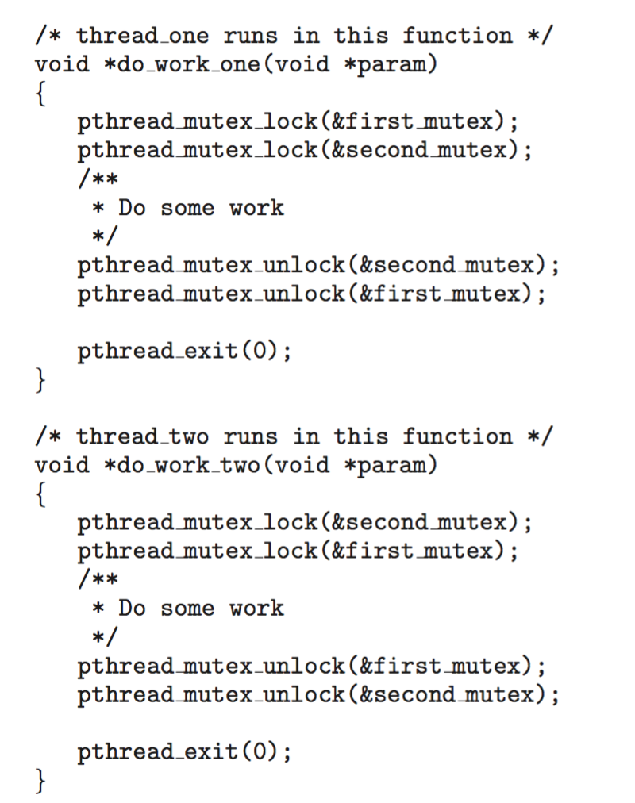
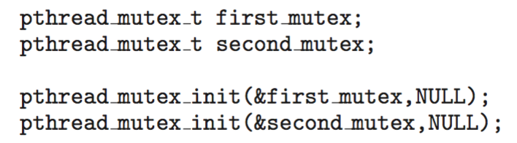
DEADLOCK IN MULTI-THREADED APPLICATION
Two mutex locks are created an initialized:

Slide 10
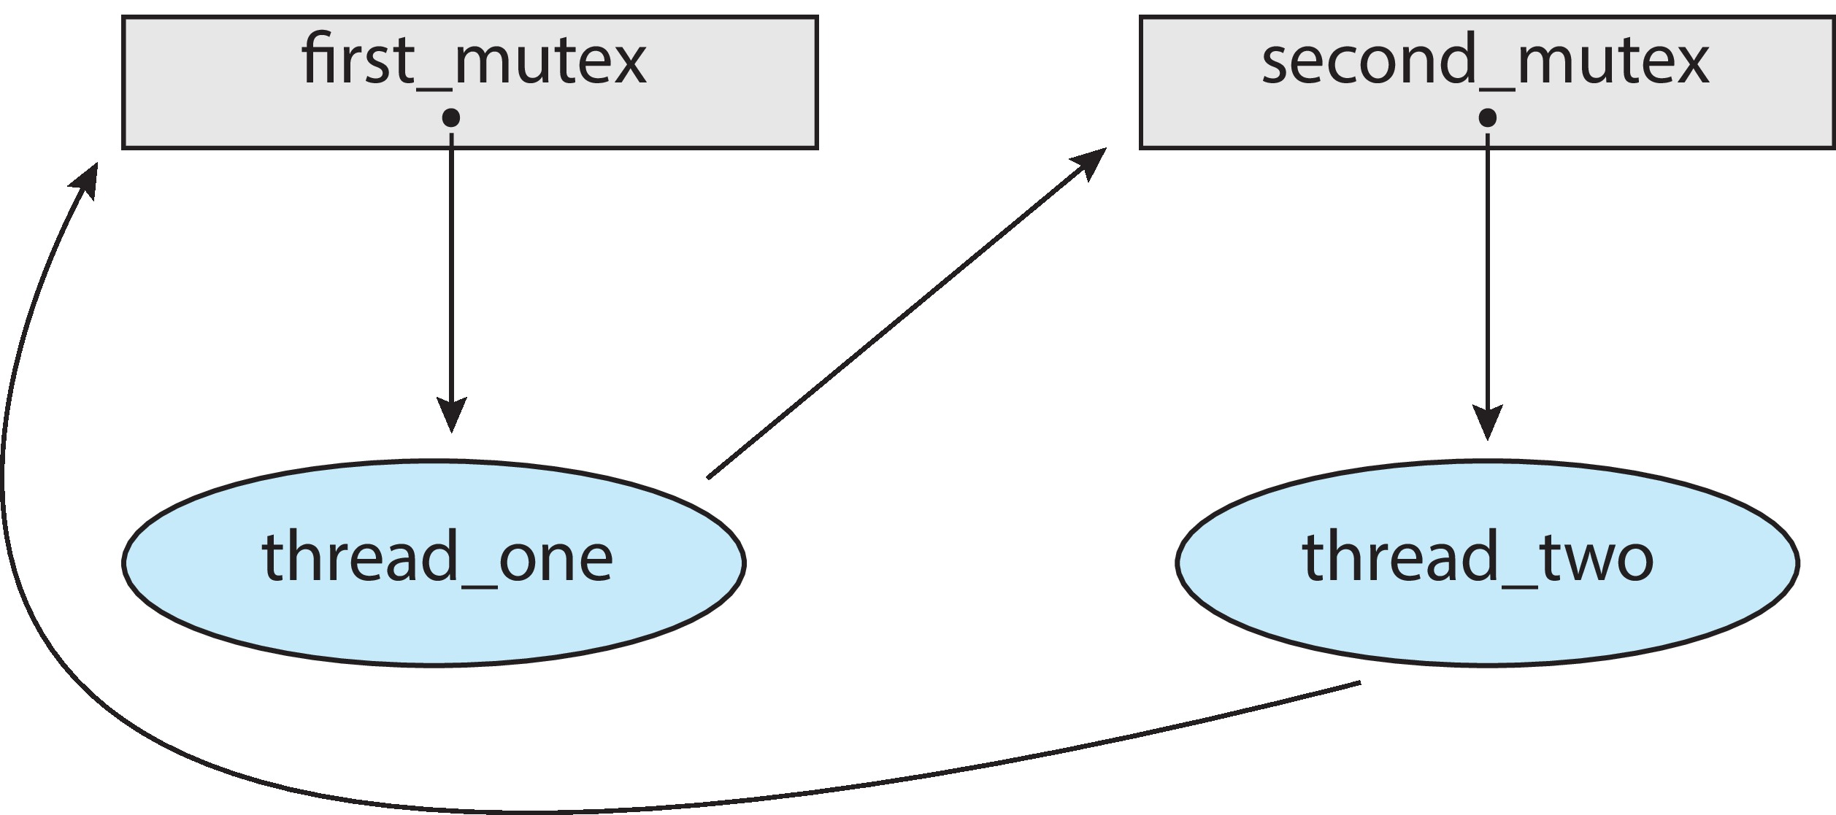
DEADLOCK IN MULTI-THREADED APPLICATION
Deadlock is possible if thread 1 acquires first_mutex and thread 2 acquires second_mutex.
Thread 1 then waits for second_mutex and thread 2 waits for first_mutex.
Illustrated with a resource allocation graph:

Slide 11
LIVELOCK
A variant of deadlock
A situation in which two or more threads continuously change their state in response to changes in the other thread(s) without doing any useful work.
Similar to deadlock in that no progress is made but differs in that neither thread is blocked or waiting for anything.
Human example of livelock:
Two people who meet face-to-face in a corridor
Each moves aside to let the other pass
But end up swaying from side to side without making any progress
Because they always move the same way at the same time.

Slide 12
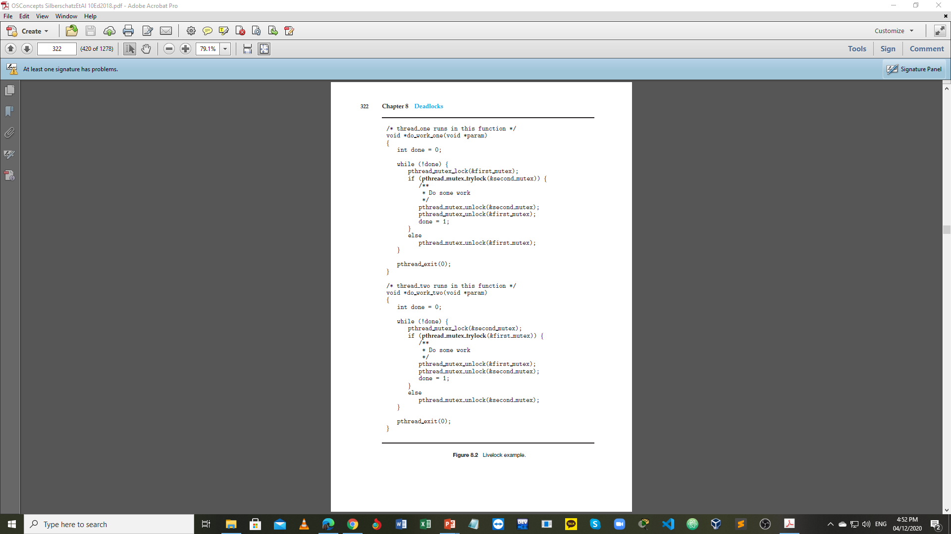
LIVELOCK EXAMPLE

Slide 13
DEADLOCK CHARACTERIZATION
Four Necessary Conditions (Coffman Conditions) that Characterize Deadlock:
Mutual exclusion:
Only one thread at a time can use a resource
Hold and wait:
A thread holding at least one resource is waiting to acquire additional resources held by other threads
No preemption:
A resource can be released only voluntarily by the thread holding it, after that thread has completed its task
Circular wait:
There exists a set {T₀, T₁, …, T_{n}} of waiting threads such that T₀ is waiting for a resource that is held by T₁, T₁ is waiting for a resource that is held by T₂, …, T_{n–1} is waiting for a resource that is held by T_{n}, and T_{n} is waiting for a resource that is held by T₀.

Slide 14
(SYSTEM) RESOURCE-ALLOCATION GRAPH
Consists of a set of vertices V and a set of edges E
V is partitioned into two types of nodes:
T = {T₁, T₂, …, T_{n}}
the set consisting of all the threads in the system
R = {R₁, R₂, …, R_{m}}
the set consisting of all resource types in the system
Request edge: directed edge T_{i} → R_{j}
Assignment edge: directed edge R_{j} → T_{i}

Slide 15
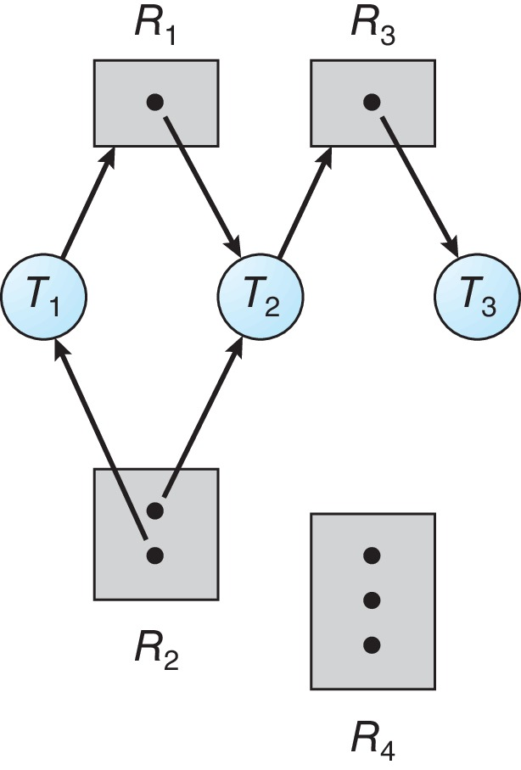
RESOURCE-ALLOCATION GRAPH: EXAMPLE
One instance of R₁
Two instances of R₂
One instance of R₃
Three instances of R₄
T₁ holds one instance of R₂ and is waiting for an instance of R₁
T₂ holds one instance of R₁, one instance of R₂, and is waiting for an instance of R₃
T₃ holds one instance of R₃

Slide 16
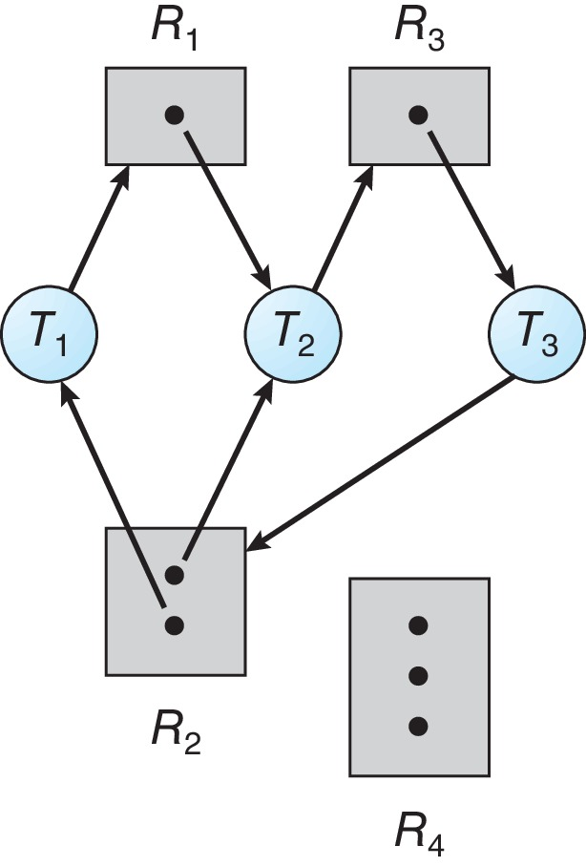
RESOURCE-ALLOCATION GRAPH WITH A DEADLOCK

Slide 17
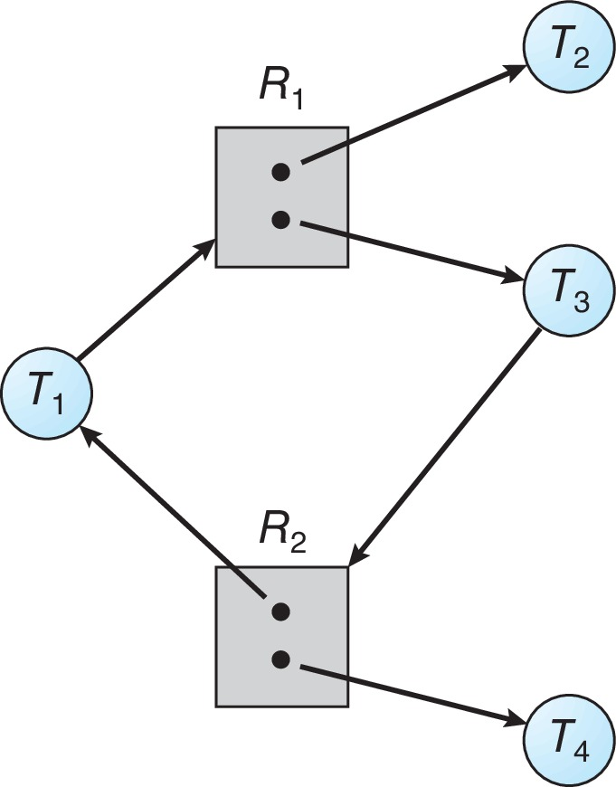
GRAPH WITH A CYCLE BUT NO DEADLOCK

Slide 18
BASIC FACTS
If graph contains no cycles ⇒ no deadlock
If graph contains a cycle ⇒
if only one instance per resource type, then deadlock
if several instances per resource type, possibility of deadlock

Slide 19
METHODS FOR HANDLING DEADLOCKS
Ensure that the system will never enter a deadlock state:
Deadlock prevention
Deadlock avoidance
Allow the system to enter a deadlock state, detect it and then recover
Ignore the problem and pretend that deadlocks never occur in the system

Slide 20
DEADLOCK PREVENTION
Invalidate one of the four necessary conditions for deadlock
Mutual Exclusion: not required for sharable resources (e.g., read-only files); must hold for non-sharable resources
Hold and Wait: must guarantee that whenever a thread requests a resource, it does not hold any other resources
Requires thread to request and be allocated all its resources before it begins execution, or allows thread to request resources only when the thread has none allocated to it.
Low resource utilization; starvation possible
No Preemption:
If a thread that is holding some resources requests another resource that cannot be immediately allocated to it, then all resources currently being held are released
Preempted resources are added to the list of resources for which the thread is waiting
Thread will be restarted only when it can regain its old resources, as well as the new ones that it is requesting
Circular Wait: impose a total ordering of all resource types, and require that each thread requests resources in an increasing order of enumeration

Slide 21
CIRCULAR WAIT
Invalidating the circular wait condition is most common
Simply assign each resource (i.e. mutex locks) a unique number
Resources must be acquired in order
If: first_mutex = 1 second_mutex = 5 Code for thread_two could not be written as follows:

Slide 22
DEADLOCK AVOIDANCE
Requires that the system has additional information about how resources are to be requested
Simplest and most useful model requires that each thread declares the maximum number of resources of each type that it may need
A deadlock-avoidance algorithm dynamically examines the resource-allocation state to ensure that there can never be a circular-wait condition
Resource-allocation state is defined by the number of available and allocated resources, and the maximum demands of the threads

Slide 23
SAFE STATE
When a thread requests an available resource, system must decide if immediate allocation leaves the system in a safe state
System is in safe state if there exists a sequence <T₁, T₂, ..., T_{n}> of ALL the threads in the system such that for each T_{i}, the resources that T_{i} can still request can be satisfied by currently available resources plus the resources held by all T_{j}, with j < i
That is:
If T_{i} resource needs are not immediately available, then T_{i} can wait until all T_{j} have finished
When T_{j} is finished, T_{i} can obtain needed resources, execute, return allocated resources, and terminate
When T_{i} terminates, T_{i +1} can obtain its needed resources, and so on

Slide 24
BASIC FACTS
If a system is in safe state ⇒ no deadlocks
If a system is in unsafe state ⇒ possibility of deadlock
Avoidance ⇒ ensure that a system will never enter an unsafe state

Slide 25
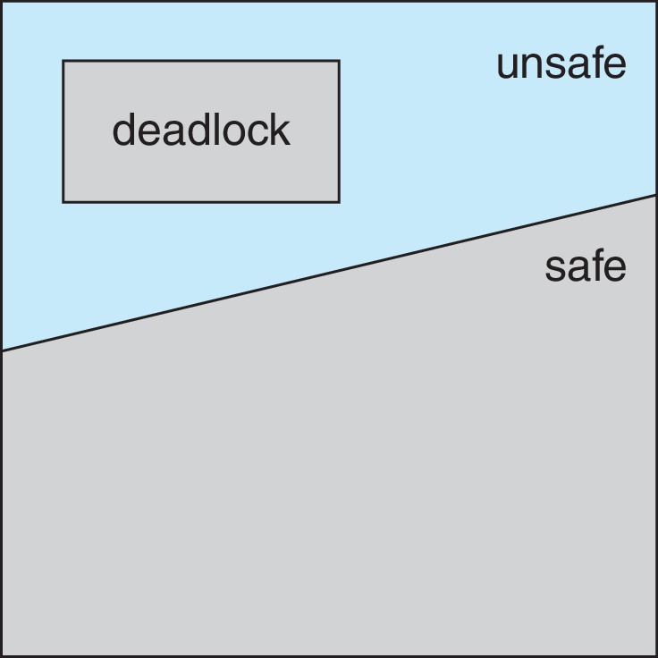
SAFE, UNSAFE, DEADLOCK STATE

Slide 26
AVOIDANCE ALGORITHMS
Single instance of a resource type
Use a Resource-Allocation Graph
Multiple instances of a resource type
Use the Banker’s Algorithm

Slide 27
RESEARCH-ALLOCATION GRAPH SCHEME
Claim edge T_{i} → R_{j} indicates that thread T_{i} may request resource R_{j} (represented by a dashed line)
Claim edge is converted to request edge when a thread requests a resource
Request edge is converted to an assignment edge when the resource is allocated to the thread
When a resource is released by a thread, assignment edge reconverts to a claim edge
Resources must be claimed a priori in the system
Before thread T_{i} starts executing, all its claim edges must already appear in the resource-allocation graph

Slide 28
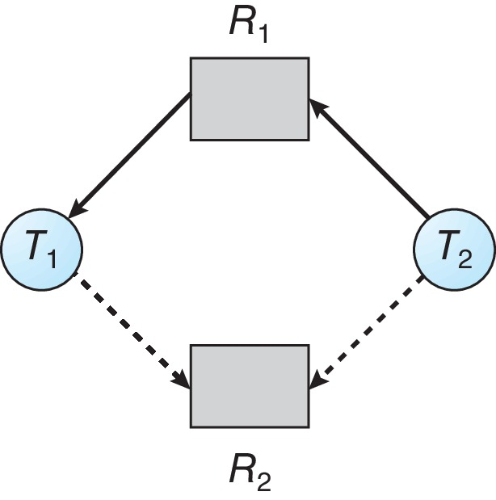
RESOURCE-ALLOCATION GRAPH (DEADLOCK AVOIDANCE)

Slide 29
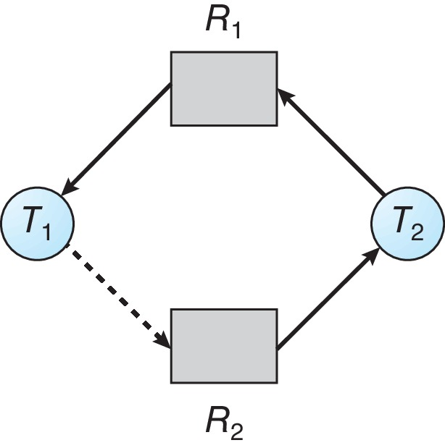
UNSAFE STATE IN RESOURCE-ALLOCATION GRAPH

Slide 30
RESOURCE-ALLOCATION GRAPH ALGORITHM
Suppose that T₂ requests R₂.
Although R₂ is currently free, it cannot be allocated to T₂, since this action will create a cycle in the graph
A cycle, as mentioned, indicates that the system is in an unsafe state.
If T₁ requests R₂, and T₂ requests R₁, then a deadlock will occur.

Slide 31
BANKER’S ALGORITHM
Multiple instances of resources
Each thread must declare the maximum number of instances of each resource type that it may need
When a thread requests a resource it may have to wait
When a thread gets all its resources it must return them in a finite amount of time

Slide 32
DATA STRUCTURES: BANKER’S ALGORITHM
Let n = number of threads in the system, and m = number of resources types.
Available: Vector of length m.
If Available [j] = k, then k instances of resource type R_{j} are available
Max: n x m matrix.
If Max [i][j] = k, then thread T_{i} may request at most k instances of resource type R_{j}
Allocation: n x m matrix.
If Allocation [i][j] = k then thread T_{i} is currently allocated k instances of resource type R_{j}
Need: n x m matrix.
If Need [i][j] = k, then thread T_{i} may need k more instances of R_{j} to complete its task
Note: Need [i][j] = Max [i][j] – Allocation [i][j]

Slide 33
SAFETY ALGORITHM
Let Work and Finish be vectors of length m and n, respectively. Initialize:
Work = Available
Finish[i] = false for i = 0, 1, ..., n − 1
Find an index i such that both:
a. Finish[i] == false
b. Need_{i} ≤ Work
If no such i exists, go to step 4
Work = Work + Allocation_{i}
Finish[i] = true
Go to step 2
If Finish[i] == true for all i, then the system is in a safe state
Note:
This algorithm may require an order of O(m × n²) operations to determine whether
a state is safe.

Slide 34
RESOURCE-REQUEST ALGORITHM
Request_{i} = request vector for thread Ti
If Request_{i} [j] == k, then thread T_{i} wants k instances of resource type R_{j}
If Request_{i} ≤ Need_{i}, go to step 2. Otherwise, raise an error condition, since the thread has exceeded its maximum claim
If Request_{i} ≤ Available, go to step 3. Otherwise, T_{i} must wait, since resources are not available
Pretend to allocate requested resources to T_{i} by modifying the state as follows:
Available = Available – Request_{i}
Allocation_{i} = Allocation_{i} + Request_{i}
Need_{i} = Need_{i} – Request_{i}
If safe ⇒ the resources are allocated to T_{i}
If unsafe ⇒ T_{i} must wait, and the old resource-allocation state is restored

Slide 35
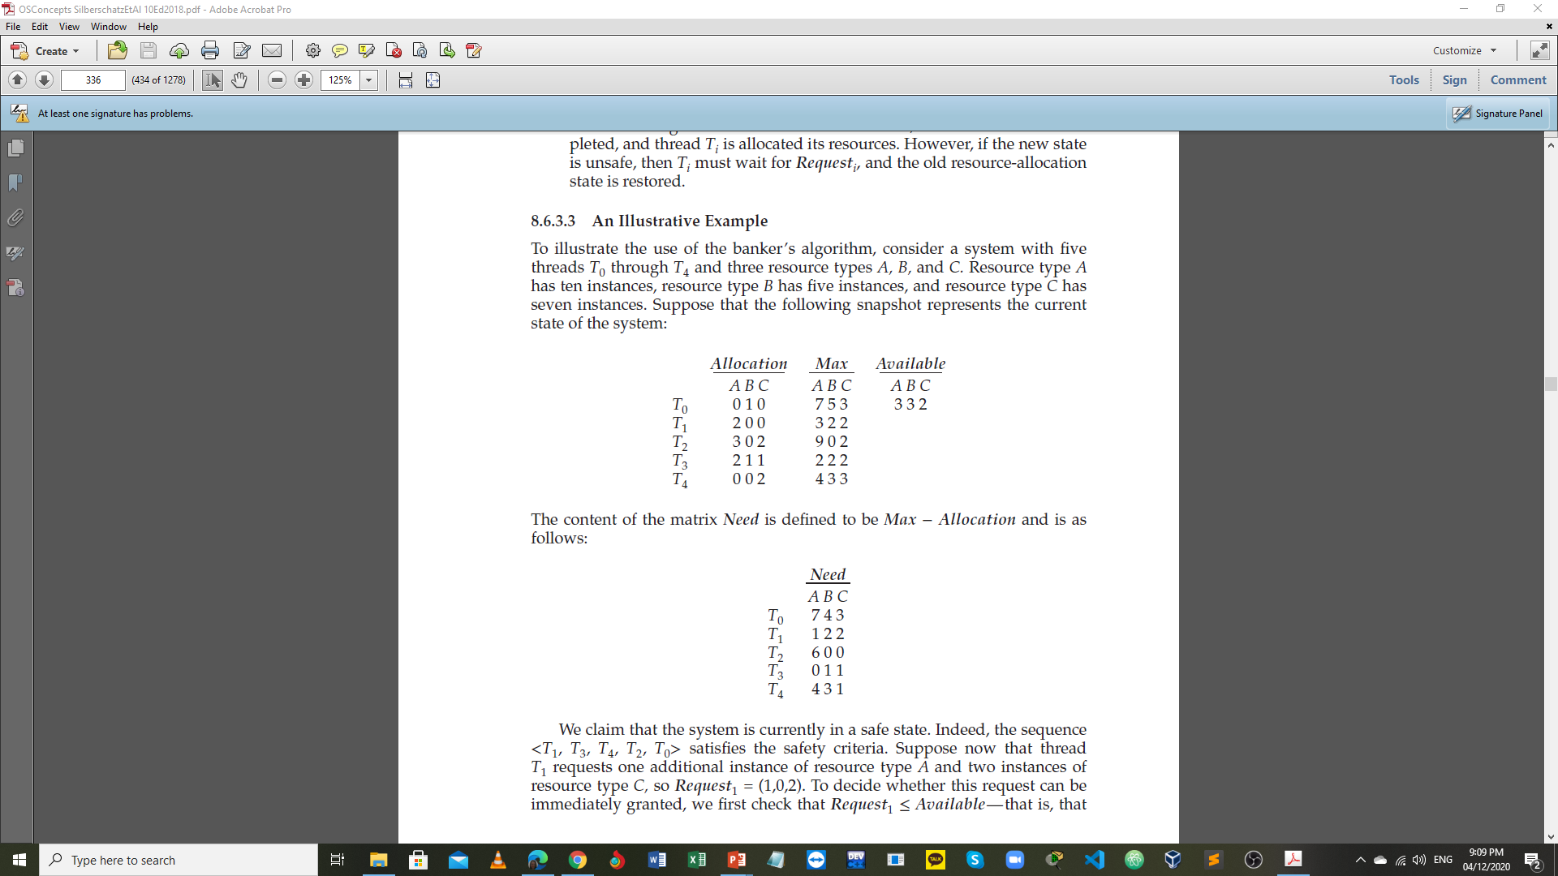
BANKER’S ALGORITHM: EXAMPLE1 – P1
Given:
Consider a system with:
5 threads T₀ through T₄
3 resource types A, B, and C
A (10 instances), B (5 instances), and C (7 instances)
Suppose that the following snapshot represents the current state of the system:

Slide 36
BANKER’S ALGORITHM: EXAMPLE1 – P2
The content of the matrix Need is defined to be Max – Allocation and is as follows:
Task:
Determine the sequence that will make the system in a safe state.
Notes:
The system is in a safe state since the sequence < T₁, T₃, T₄, T₀, T₂> or < T₁, T₃, T₄, T₂, T₀> satisfies the safety criteria

Slide 37
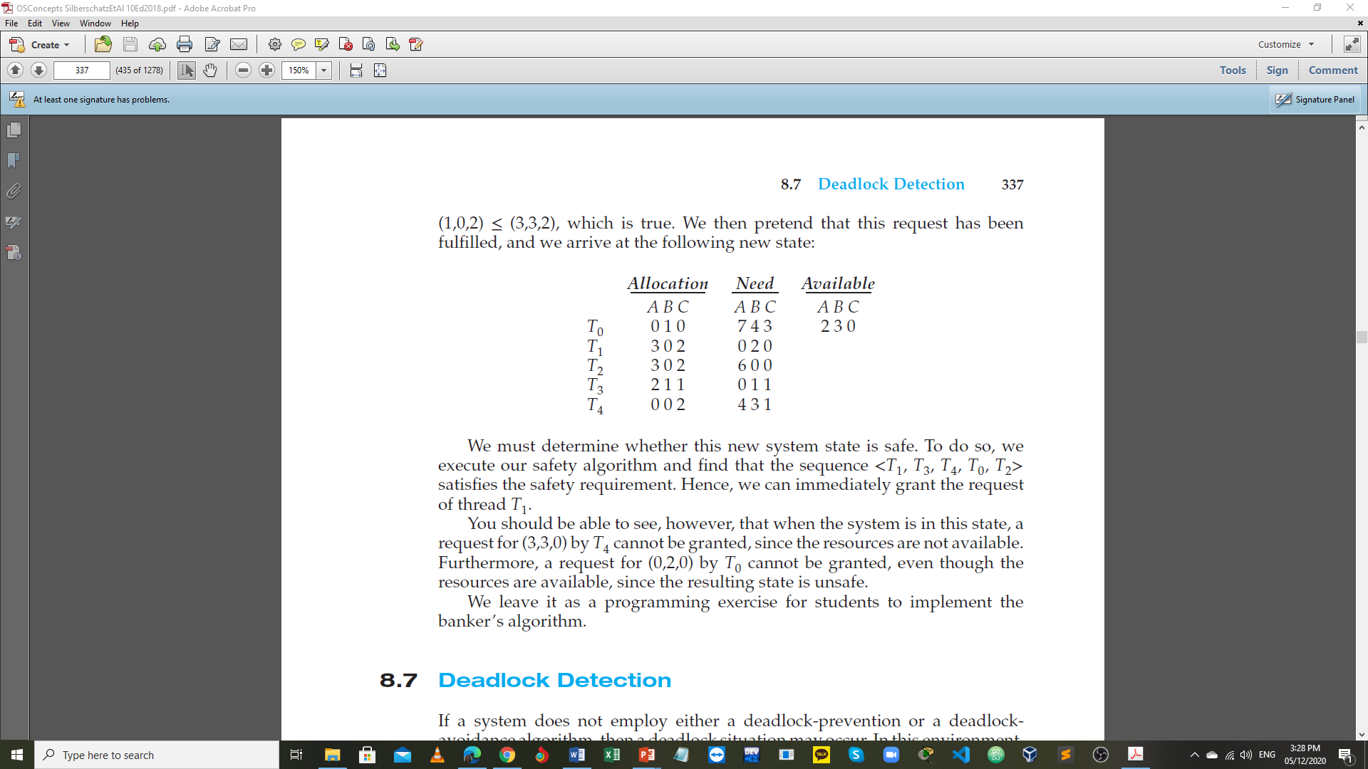
BANKER’S ALGORITHM: EXAMPLE 2
Given:
Suppose T₁ requests:
1 additional instance of A
2 instances of C
[Request₁ = (1,0,2)]
Task:
Can this request be granted?
Check that Request ≤ Available (that is, (1,0,2) ≤ (3,3,2) ⇒ true
Try the following:
Can request for (3,3,0) by T₄ be granted?
Can request for (0,2,0) by T₀ be granted?
Notes:
Executing safety algorithm shows that sequence < T₁, T₃, T₄, T₀, T₂> satisfies safety requirement

Slide 38
DEADLOCK DETECTION
Allows system to enter deadlock state
Detection algorithm
Recovery scheme

Slide 39
SINGLE INSTANCE OF EACH RESOURCE TYPE
Maintain wait-for graph
Nodes are threads
T_{i} → T_{j} if T_{i} is waiting for T_{j}
Periodically invoke an algorithm that searches for a cycle in the graph. If there is a cycle, there exists a deadlock
An algorithm to detect a cycle in a graph requires an order of n² operations, where n is the number of vertices in the graph

Slide 40
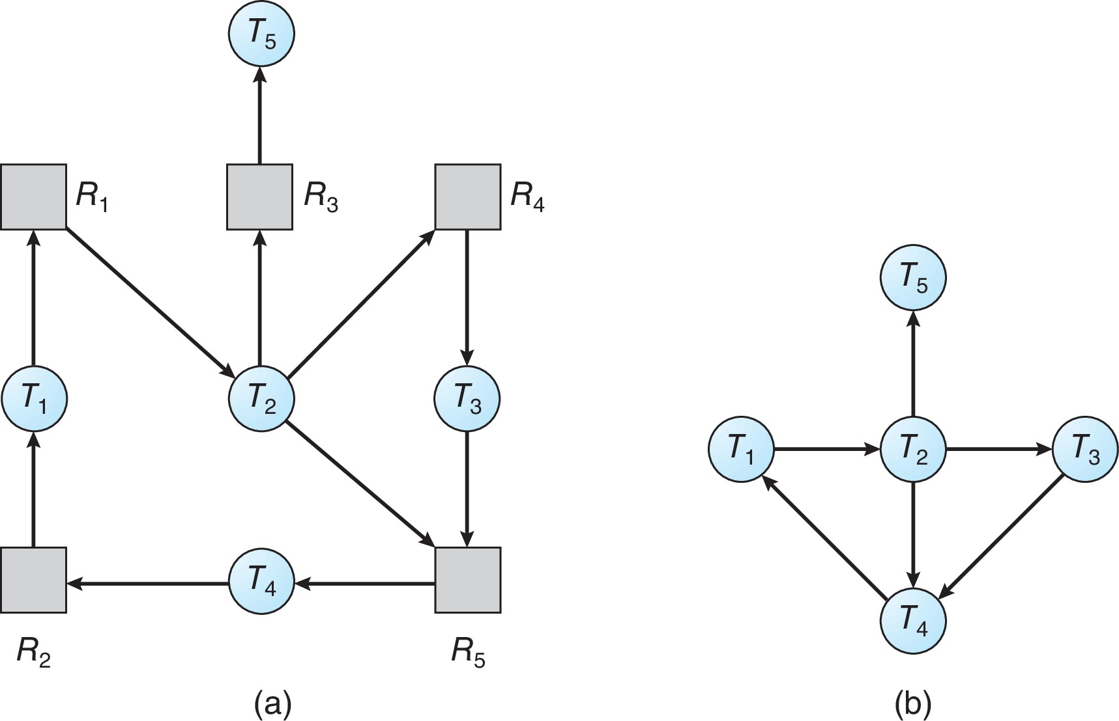
RESOURCE-ALLOCATION GRAPH AND WAIT-FOR GRAPH
Resource-Allocation Graph
Corresponding wait-for graph

Slide 41
SEVERAL INSTANCES OF A RESOURCE TYPE
Available:
A vector of length m indicates the number of available resources of each type
Allocation:
An n x m matrix defines the number of resources of each type currently allocated to each thread
Request:
An n x m matrix indicates the current request of each thread
If Request [i][j] = k, then thread T_{i} is requesting k more instances of resource type R_{j}

Slide 42
DETECTION ALGORITHM: P1
Let Work and Finish be vectors of length m and n, respectively. Initialize:
Work = Available
For i = 0, 1, …, n -1,
if Allocation_{i} ≠ 0, then Finish[i] = false;
otherwise, Finish[i] = true
Find an index i such that both:
(a) Finish[i] == false
(b) Request_{i} ≤ Work
If no such i exists, go to step 4.

Slide 43
DETECTION ALGORITHM: P2
Work = Work + Allocation_{i} Finish[i] = true Go to step 2.
If Finish[i] == false for some i, 0 ≤ i < n, then the system is in a deadlocked state.
Moreover, if Finish[i] == false, then T_{i} is deadlocked.
Note:
This algorithm requires an order of O(m × n²) operations to detect whether the system is in a deadlocked state.

Slide 44
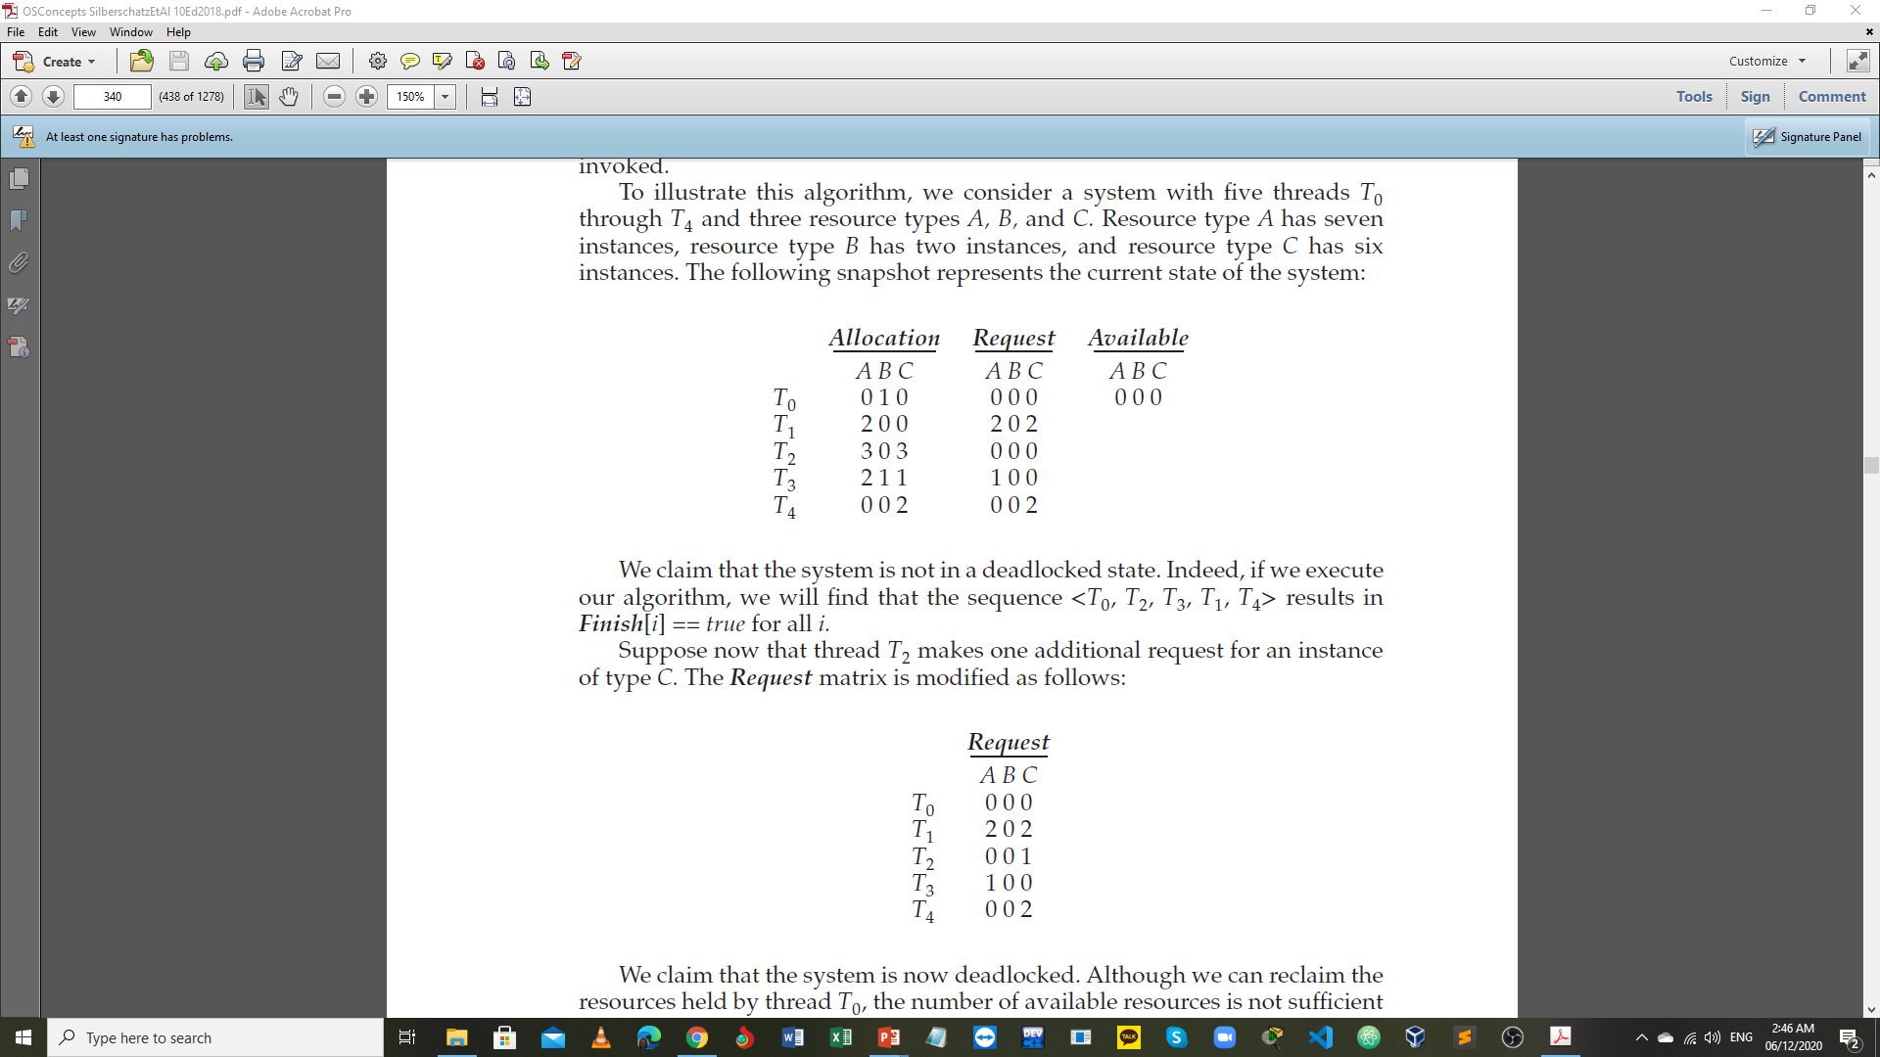
DETECTION ALGORITHM: EXAMPLE - P1
Given:
Consider the following:
Five threads: T₀ through T₄
Three resource types: A, B, C
A (7 instances), B (2 instances), and C (6 instances)
Snapshot of the current state of the system:
Task:
Find the safe sequence to check if the system is in a deadlocked state or not.
Notes:
Sequence <T₀, T₂, T₃, T₁, T₄> will result in Finish[i] = true for all i

Slide 45
DETECTION ALGORITHM: EXAMPLE - P2
Given:
Suppose T₂ requests an additional instance of type C.
The Request matrix is modified as follows:
Task:
Determine the state of the system, if deadlock exists or not.
Notes:
State of system:
Can reclaim resources held by thread T₀, but insufficient resources to fulfill other threads’ requests
Deadlock exists, consisting of threads T₁, T₂, T₃, and T₄

Slide 46
DETECTION-ALGORITHM USAGE
When, and how often, to invoke the detection algorithm depends on:
How often a deadlock is likely to occur?
How many threads will be affected by deadlock when it happens?
A less expensive alternative is simply to invoke the algorithm at defined intervals (for example, once per hour or whenever CPU utilization drops below 40 percent).
A deadlock eventually cripples system throughput and causes CPU utilization to drop.
If the detection algorithm is invoked at arbitrary points in time, the resource graph may contain cycles.
In this case, we generally cannot tell which of the many deadlocked threads “caused” the deadlock.

Slide 47
RECOVERY FROM DEADLOCK
PROCESS and THREAD TERMINATION
Abort all deadlocked processes
Abort one process at a time until the deadlock cycle is eliminated
In which order should we choose to abort?
Priority of the process
How long process has computed, and how much longer to completion
Resources the process has used
Resources process needs to complete
How many processes will need to be terminated

Slide 48
RECOVERY FROM DEADLOCK
RESOURCE PREEMPTION
Selecting a victim:
minimize cost
Rollback:
return to some safe state, restart process for that state
Starvation:
same process may always be picked as victim, ensure that a process can be picked as a victim only a (small) finite number of times
include number of rollbacks in the cost factor

Slide 49
CS 3104 – OPERATING SYSTEMS
End of Chapter 8
Deadlocks

